Slide 1
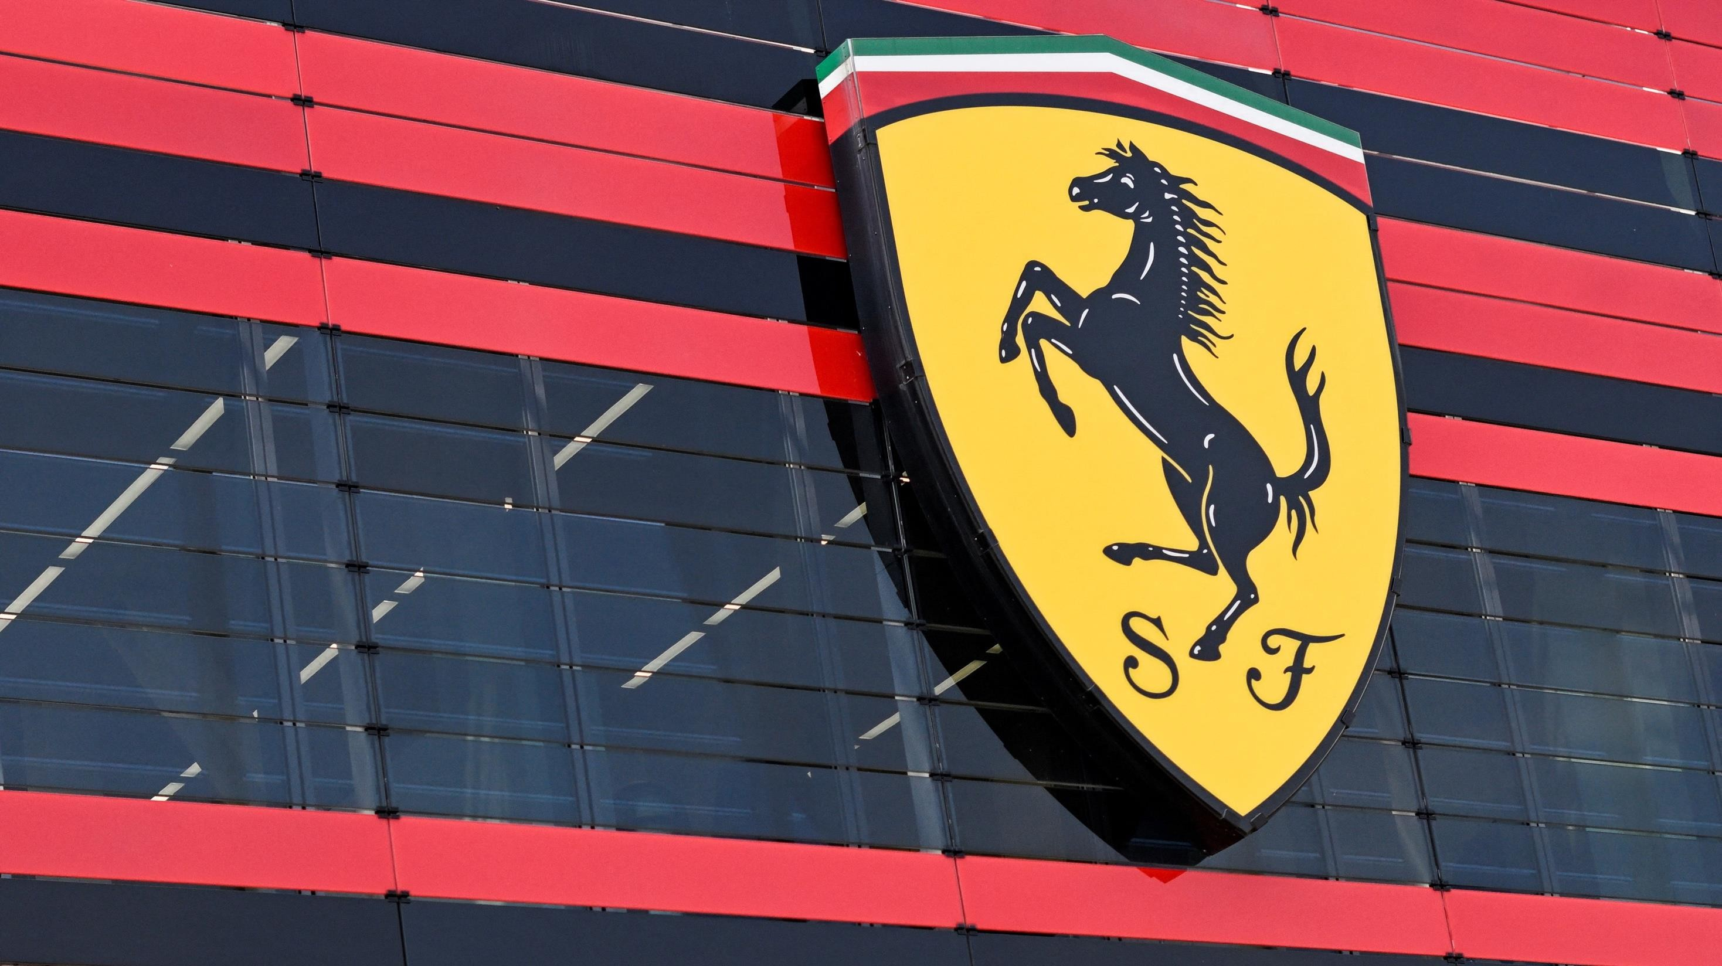
The Race for the Future: Ferrari’s
Next Big Move
Gravity Defiers
Tamerlan Gasimov | Paige McFarland | Veer Singh | Stephanie Tomaz | Dinara Zamantayeva University of Toronto, March 9th, 2025

Slide 2

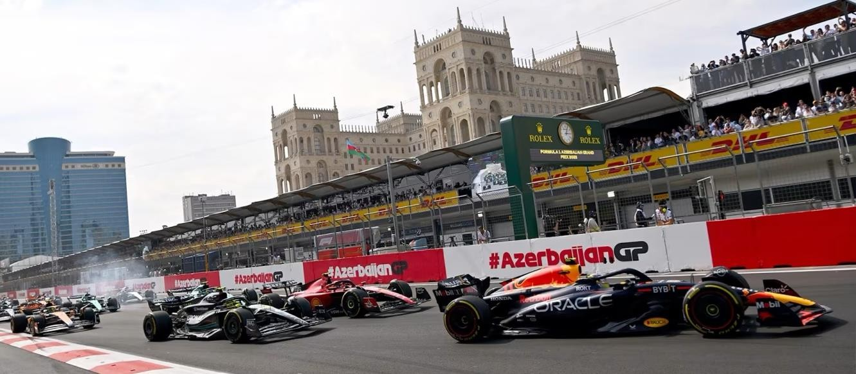
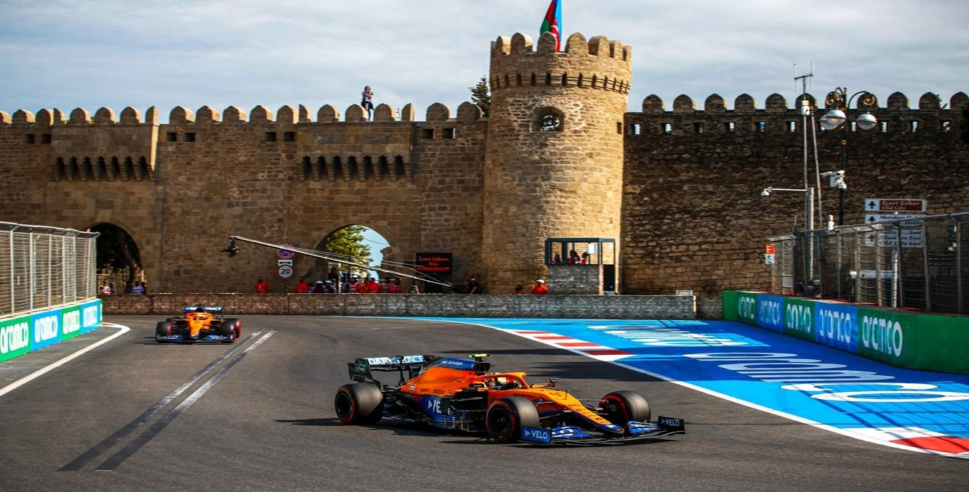
Table of Contents s Abbreviations
I. Executive Summary | 3
II. Industry Analysis | 4 - G
III. Company Analysis
1. Ferrari | 10 - 11
2. Pirelli | 12
3. Strategic Fit | 13
IV. Financial Analysis
1. Comparables | 14 - 18
2. Discounted Cash Flow | 1G - 20
3. Synergies | 21 - 22
V. Acquisition Feasibility | 23 - 25
VI. Alternative Solution | 26 - 32
VII. Conclusion | 33
Appendix | 34 - 37
Bibliography | 38

Slide 3
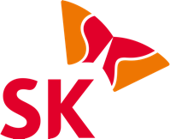


Executive Summary
Ferrari should not acquire Pirelli, but acquire SK On global EV battery developer to pursue its electrification goals
Pirelli is an Italian tire manufacturing company, and the fifth largest tire manufacturer in the world.
Tires are a necessity, but Ferrari already has strategic
partnerships to meet its needs.
Pirelli is currently valued at $9,385M USD.
Acquiring Pirelli would require over $10,000M USD.
Regardless of the $4,335.15M in synergies, acquiring it at a fair
valuation it will not give Ferrari any competitive edge financially
given its low growth, inability to recover acquisition costs, while
still needed to invest in EV’s to achieve strategic objectives.
Misalignment of operations, expertise and future direction make the acquisition unfeasible.
Ferrari's brand would be diluted and its profitability greatly and it
would still need to pursue further acquisitions to accomplish its
objectives.
SK On is the battery subsidiary of SK Innovation and the fifth
largest Battery Producer in the world.
Have existing partnership with Ferrari as exclusive battery supplier
Fits strategically with Ferrari's focus on integrating cutting-edge EV
battery technology in its luxury offering.
SK ON is currently valued at $2,741 millions USD
Acquiring SK ON could be achieved at a lower multiple, while earning $4,907.66M in synergies
Historical unprofitability would allow Ferrari to acquire at a lower
multiple, and their strong growth rate and improving profitability would allow Ferrari to meet its targets.
Aligned with Ferrari's long-term strategy and expands on Ferrari's abilities to provide personalized solutions for electric cars with its BaaS and ESaaS solutions
Allows Ferrari to make quality batteries that complement its luxury
offering for a growing electric automobile future
Ferrari should NOT AQUIRE Pirelli
Ferrari should instead AQUIRE SK On
Executive |  | Industry |  | Company |  | Financial |  | Acquisition |  | Alternative |  | Conclusion
Summary |  | Overview |  | Analysis |  | Analysis |  | Feasibility |  | Solution

Slide 4




Revving Up the Luxury Automotive Boom
How the rise of HNWIs is shifting gears in key sectors
Rising population of UHNWI Worldwide…
… leading to growth in key market segments …the following market trends
Segmentation of Luxury Car Market by Vehicle Cost Range
Population
North America
10+ new entrants, global players from China, Europe, Japan, C the U.S.
Market shift towards electrification,
driving higher product launches.
+26%
CAGR ’21 - ’31
14%
3%
10%
8%
Ultra-Luxury Segment
+38%
Asia
+22%
Europe
>:500k
SUV sales to 2X as more OEMs introduce
EV SUVs.
Increasing number of luxury models released since 2021.
:300k – :500k
+28%
Other
:150k – :233k
Increased competition from new entrants expanding market size.
Existing market players remain dominant
through frequent product launches.
2022 2024 202c 2028 202S
with a keen focus on electrification…
Time
:80k – :143k
Slower transition to EVs as the ICE segment remains a popular choice due to discretionary and experiential value.
… and a rise in popularity of SUVs …driving changes
EV Adoption by Price Segments
2021
2026
50% of buyers prefer SUVs for
their next purchase
Growth drivers: Shifting value pools, technology advancements, and evolving consumer
preferences
85%
70%
75%
2031
EU’s 2035 CO₂ emissions policy outline automobile manufacturers to cut emissions by 55% by 2030 and a full transition to producing zero emissions vehicles by 2035. Boutique manufacturers are exempt from both requirements, while ultra luxury manufacturers like Ferrari and McLaren are exempt from the 2030 targets.
10+ new BEV SUVs launching in
$150K-$500K segment by 2027
48%
Effects: Automakers
expand EVs via DTC sales,
Battery-aaS, and OTA
updates, while demand for ADAS, smart connectivity, and better batteries drives
innovation.
38%
38%
SUV Market Share: 25% → 40%
(By 2031)
30%
28%
15%
4%
2%
3%
$500K+ SUV Sales: 15% → 50%
(By 2031)
:80k-:14Sk
:150k-:2SSk
:300k-:500k
500k+
(McKinsey C Company, 2022), (Knight Frank, 2024), (Forbes, 2023)
Executive | Industry | Company | Financial | Acquisition | Alternative | Conclusion
Summary | Overview | Analysis | Analysis | Feasibility | Solution

Slide 5
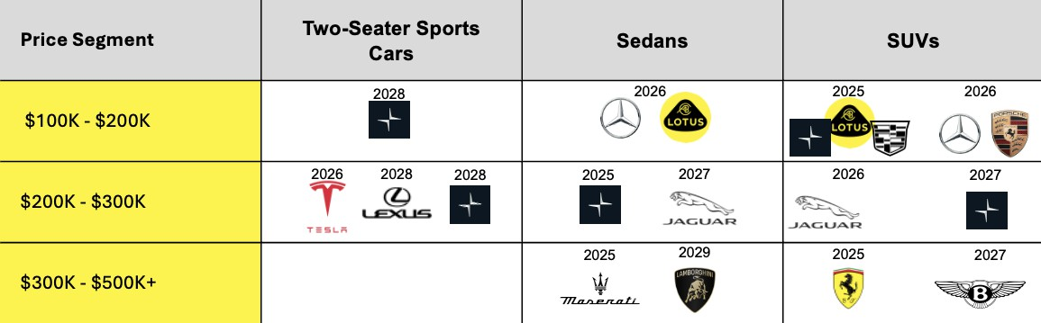







EV Battery Market
EV Battery market presents high-growth opportunities, following global EV trends
Growth Drivers of EV Battery Market
EV Battery Market Revenue Preparing for future EV Releases
15.8% CAGR
Increasing Sales of EVs: Rising demand, government incentives, stricter emissions regulations, driving EV adoption
371
Technology Advancements : Innovation in battery chemistry C design, improving energy density, charging speed, lifespan, performance.
Expansion of Charging Infrastructure: Growing investments in charging stations reducing range anxiety, making EVs more accessible.
85
2024
2034E
Increasing number of releases of electric cars, particularly electric SUVs
Key Players
EV Battery Trends
LIB manufacturing capacity
Performance and Innovation
12
10
8
6
4
2
0
Lithium-ion Battery: dominates due to superior energy density, long lifespan, declining production costs.
21% CAGR
SK On
Gotion High-tech
CALB
Toshiba
BYD
Panasonic LG Energy Solution
Asia Pacific North America Europe
7,650
Samsung SDI
Sunwoda
CATL
Eve Energy Exide Industries
Solid-State Batteries for EVs: Have the potential to be better than lithium-ion batteries in terms of energy density, safety and lifespan, however are more expensive to manufacture, and are still in process of being developed for EV’s, expected around 2026- 2027 for EVs.
1,960
0
1 2 3 4 5 6 7 8
Low to High Luxury Market Focus
9 10 11 12
Market Share
2023 2030
LIB manufacturing capacity expected to grow, matching the high demand for EVs. Asia Pacific expected to lead, Europe expected to grow modestly.
There are many key players in the EV Battery market, with varying levels of luxury market focus, and R&D investments in innovation
(Towards Automotive, 2025), (Software, D., 2023), (IRENA, 2024)
Executive | Industry | Company | Financial | Acquisition | Alternative | Conclusion
Summary | Overview | Analysis | Analysis | Feasibility | Solution

Slide 6



Smarter Cars
A rise in digitization of the automobile industry
As revenues get more digital…
Automotive Revenues in US$bn
US $3.5tn
9,154
Automobile suppliers look ahead…
Expansionary trends indicate the following
approach to M&A activity:
Digital: Mobility Services Autonomy
Connected Ecosystem Digital: Car Features Digital: Vehicle Operation Digital: Sales C Finance
Traditional: Mobility Services Traditional: Vehicle Operation Traditional: Sales C Finance Car Sales
Digitally enabled revenues
6,471
Complement hardware with software and data for ADAS
Complement the Product & Technology Portfolio for E-Drive Supply
Become a Comprehensive Solutions Provider in Specific Segments
Enter OEM Supplier Market or New Regional Markets
4,869
3,803
Traditional auto revenues
2021 2025 2030 2040
at rapidly growing supporting services & in target markets…
EV Charging-as-a-service
(’24 – ‘32)
18% CAGR
Advanced driver- assistance systems (’25 - ’33)
18% CAGR
Battery-as-a-service
(’23 - ’30)
21% CAGR
EUROPE
Mature
More than 300,000 public and private charge points will be required by 2030. |  | Growing adoption could reduce the number of accidents by ~15% by 2030 | 30 new Battery Rental stations have opened across five countries, with more on the way.
Aim to install 500,000 universal public EV chargers nationwide by 2030. |  | Increasing market penetration (>G0%) for several ADAS features | Expansion of startups like Ample due to >G5% of EV electricity demand being for electric cars.
Usage of E4Ws and E2Ws are growing at soaring rates in emerging markets. |  | Increasing adoption in Japan and South Korea; increasing consumer preference in China. | Numerous startups within region, including key industry players like NIO.
AMERICAS
ASIA
Developing
(Fortune Business Insights, 2024), (Accenture, 2022), (Global Market I nsights, 2024), (Straits Research, 2024), (Kearney, 2021)
Executive | Industry | Company | Financial | Acquisition | Alternative | Conclusion
Summary | Overview | Analysis | Analysis | Feasibility | Solution

Slide 7
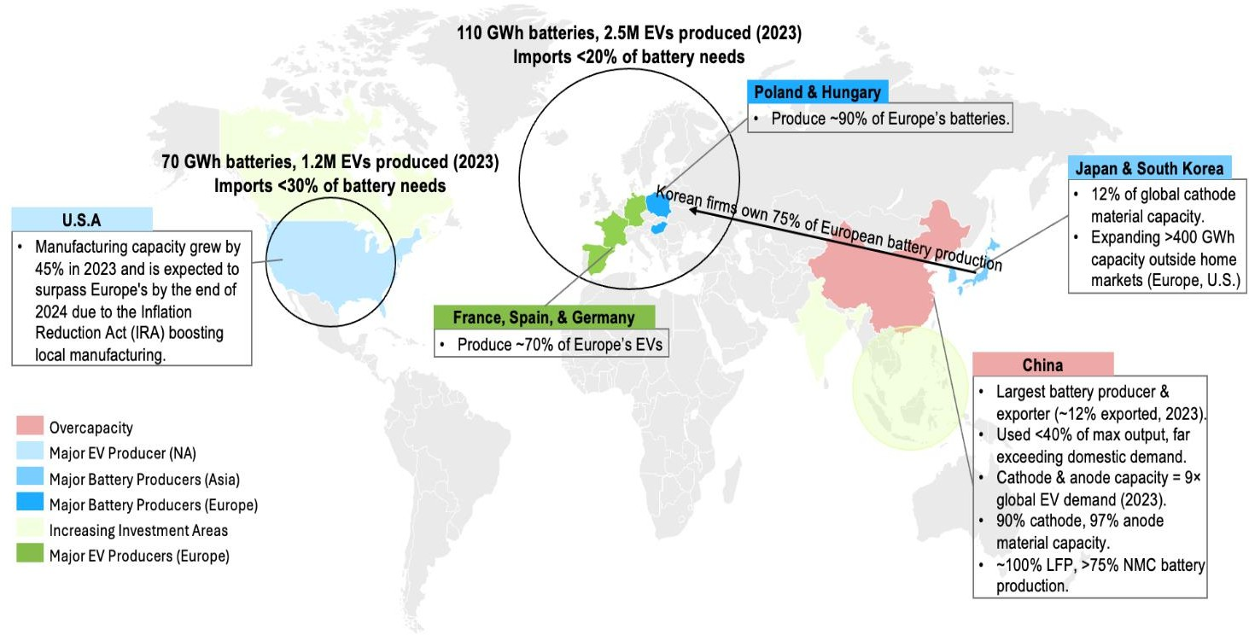
Powering the engines of expansion
Supply chains, batteries, and the road ahead
While supply chain disruptions are anticipated …
The surge in EV battery demand is driving higher extraction and refining of critical raw materials, particularly lithium, cobalt, and nickel.
Lithium carbonate global equivalent demand
2030, supply 2021 s 2030, kt
Nickel global equivalent demand 2030,
supply 2021 s 2030, kt
Australia China Chile
Rest of the world Global
-55%
Indonesia Philippines France
Rest of the world
-8%
3,250
4,050
Global
32%
7%
47%
G%
17%
52%
C0% of IRA
investments under Trump Administration
20%
G%
10%
16%
14%
28%
17%
46%
2G%
45%
2021 Supply 2030 Demand 2030 Base Scenario 2021 Supply
… there is a push towards regionalisation.
2030 Demand
2030 Base Scenario
Cell suppliers are expanding capacity in Europe, the U.S., and other key markets to be closer
to automakers. By 2030, these regions could account for ~40% of global capacity.
Global announced nameplate capacity for Li-ion batteries,
GWh/ year
Rest of Asia North America Europe
China
68%
Challenges like project delays, underutilized capacity, and reliance on long-term contracts suggest the market will remain supplier-dominated. China maintains significant overproduction capacity while Europe and North America may struggle to meet local demand.
62%
+43%
+20%
1G%
73%
13%
13%
Overcoming challenges involves strategic sourcing of minerals, expanding on battery chemistries, improving supply chain resilience, and focusing on suppliers based on target markets.
13%
2022 2025
(IEA, 2024), (McKinsey C Company, 2023)
2030
Company Analysis
Financial Analysis
Acquisition Feasibility
Alternative Solution
Conclusion
Executive Summary
Industry Overview

Slide 8
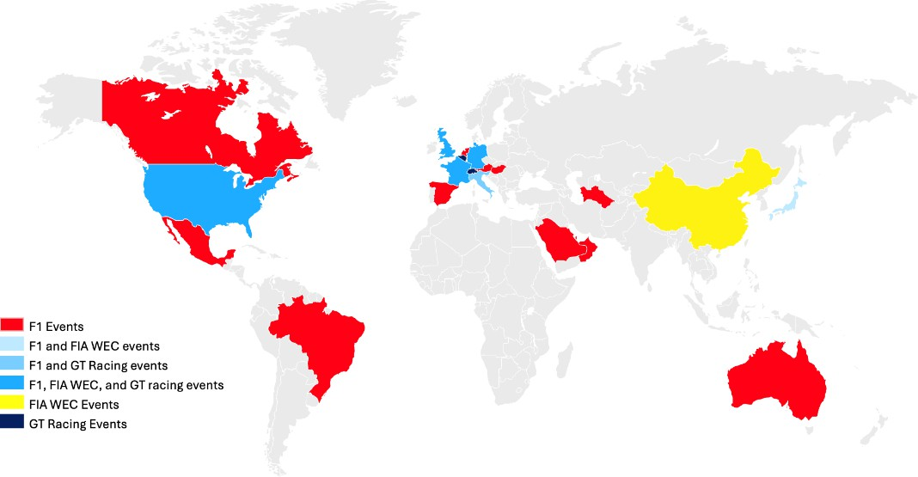
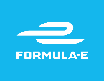




Racing into the Electric Future
Need for speed meets technology
Motorsports market continues to grow… Companies explore increased opportunities…
As racing becomes more popular globally, racing organisations look to Asia for expansion and development of racing infrastructure.
E-Sports
New regulations like the FIA Esports Code and events such as the F4 Esports Global Championship and Olympic Esports Games highlight
increasing integration of e-sports.
+10.1% CAGR
18.7C
Sponsorship
The motorsports sponsorship market is growing at ~7% CAGR (2024-
33), driven by diverse industry players and AI-driven data analytics for
sponsorship management.
7.30
EV Racing
Formula E and Extreme E are gaining traction, with increasing industry participation and viewership.
2024 2033
As electrification leads the way…
E-Racing comes into its own…
Expands to 12 racing teams; Gen2 & Gen3 battery improvements boost speed, efficiency & performance.
Hosted in climate -affected regions to raise environmental awareness; feature high-powered SUVs – built to withstand extreme conditions and push EV tech limits.
Shift towards electrification of motorsports.
Technology gets better…
The market adapts…
… and changes
Incorporating hybrid technology to meet Net Zero 2030 targets, 100% transition to e-fuels by 202C
Strategic partnership with ABB, unveiled first electric race car, 100% renewable facilities by 2028 and net zero target by 2035
Gen2
52 kWh
Gen3 70 kWh
Multimillion dollar
sponsorships in
e-sports
Top team budgets reach
:43m
Energy Recovery: Up to 250 kW
Fuel R&D
Increased investment in EV innovation, accelerating integration into consumer vehicle technology.
Traditional markets move towards
electrification
Value pool shift for EV innovation
More power and efficiency
(Fortune Business Insights, 2024)
Company Analysis
Financial Analysis
Acquisition Feasibility
Alternative Solution
Conclusion
Executive Summary
Industry Overview

Slide 9



Luxury Car Tires Market
The automobile tire market is growing at a stable rate driven by increasing demand for innovative tires
High performance tires market is growing for various reasons Competition is driven by innovation and strategic developments
EV s SUV Growth – Rising EV and SUV boost demand for specialized tires with higher torque, weight, and efficiency needs.
Geographical Presence (# countries)
200
Pirelli
+G.1% CAGR
83.C5
Michelin
Tech Innovations – Smart and airless tires enhance durability,
safety, and real-time performance tracking.
150
Hankook Tire C Technology Co., Ltd.
Yokohama
Bridgestone
58.08
Sustainability s RsD – Tire makers invest heavily in R&D for eco-
friendly materials and sustainable production.
100
Continental Group
Sumitomo Rubber Industries
The Goodyear Tire C Rubber Company
Consumer Demand for Safety: Drivers prioritize high-
performance tires for better grip, handling, and braking.
50
Magna International
0 2 4 6 8 10 12 14 16 18 20 22 24 26 28 30 32 34 36 38 40 42 44
Revenue ($USDBn) # of Manufacturing Facilities
SUV s Truck Demand – Growing SUV and truck sales drive demand for high-traction, durable, and specialized tires.
0
2025 2030
Market opportunities in car segments, technology, and product innovation
Global Perspective
Racing Cars Segment
30% | Driven by global motorsport enthusiasm, Formula 1, and demand |  | Racing tires push R&D advancements in specialized compounds, extreme durability, and performance optimization.
Market
 | from top performance car brands
Share
 | (Porsche, Audi, Mercedes, Ferrari).
Off-the-Road Vehicles
Increasing demand from mining, agriculture, and
 |  | Off-road and commercial tires benefit from enhanced construction techniques first developed in racing.
military operations, requiring high-durability tires
with enhanced traction and puncture resistance.
Commercial s Passenger Vehicles
Expansion of high-performance tires into
everyday vehicles, emphasizing fuel efficiency,
safety, and technological innovations
2023 to 2030 Expected CAGR Per Region
 |  | 4.5%
 |  | 4.8%
7.2%
 | 5.5%
 | 5.C%
North
America
Innovation-driven market with strong consumer demand for
high-performance and stylish tires.
Europe
Rapid growth fueled by premium tire demand, cutting-edge
designs, and advanced vehicle features.
Asia
Pacific
Fastest-growing region due to demand for radial tires, rising
affluence & technological advancements.
South
America
Increasing preference for premium tires with modern safety &
performance features, especially radial tires.
Middle East
CAfrica
Growth driven by high-performance and dominant radial tires & fast-growing aftermarket segment.
(Michelin, 2024), (Goodyear Corporat e, 2024), (The Business Research Co mpany, 2025)
Financial Analysis
Acquisition Feasibility
Alternative Solution
Conclusion
Executive Summary
Industry Overview
Company Analysis

Slide 10

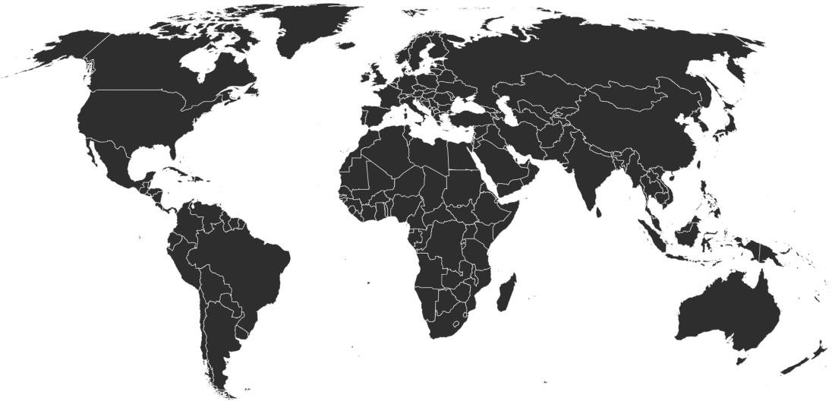





Ferrari Overview
Ferrari predominantly provides luxury vehicles, merchandise, and racing technology to high-value clients worldwide
What Ferrari Offers Ferrari’s Operations Per Region (Group Shipments)
Luxury Performance Vehicles
Known for creating iconic vehicles that blend advanced technology with
classic design for a great driving experience
2,264
2,299
1,500
1,933
1,552
1,490
1,329
836
1,520
899
3,447
3,811
695
2,900
2,831
High-Margin Lifestyle and Luxury Merchandise
Branded merchandise include apparel and accessories, enhancing brand
engagement and generating additional revenue streams
3,000
456
2,325
4,227
5,492
4,895
4,818
5,958
6,063
Racing Legacy s Technology
Cutting-edge tech from Formula 1 dominance and track-only hyper cars for
elite clientele
2018
2019
EMEA
2020
AMERICAS
2021
CHINA
2022
REST OF APAC
2023
2024 Revenue by Geography
Key Players
Ferrari’s Strategic Direction
($K)
Product Excellence: Utilizes advanced technology and sophisticated design to surpass customer expectations.
Controlled Production: Maintains exclusivity for better pricing and profitability
Electrification: introduce its first electric vehicle in 2025 with a goal to achieve 60% sales from electric and hybrid models.
Rejection of Autonomous Technology: Ferrari continues to reject the
inclusion of autonomous driving systems in its vehicles.
Market Expansion: Expanding presence in emerging markets in Asia.
Personalised Services and Customisation: The company elevates customer satisfaction by providing customized design choices and personalized ownership support.
Valuing Performance in Racing as Branding: Ferrari uses its racing legacy to strengthen both brand identity and technological advancements in their road vehicles.
3,153,445
Americas
1,33G,788
EMEA
APAC
2,183,435
Dominance in Europe and America while
diminishing China's current influence
(Ferrari, 2024)
Executive | Industry | Company | Financial | Acquisition | Alternative | Conclusion
Summary | Overview | Analysis | Analysis | Feasibility | Solution

Slide 11
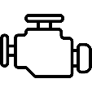





Ferrari Overview
Racing success drives revenue, while EV innovation secures Ferrari’s future
Ferrari Cars’ Components
Electric Vehicles are Around the Corner
Known for hand-assembling its
engines at the Maranello plant
Regulatory Pressure
Corporate Social
Responsibility
Market Trends
Has top suppliers like ATE, Ferodo, and Benditalia to provide high-quality braking systems
Partners with leading tire manufacturers like Pirelli, Michelin, and ZF Friedrichshafen
Teams up with Sabelt, a top provider of seats and safety belts for road and racing vehicles
New cars must reduce average CO2 emissions by 55%
by 2030 and 100%
by 2035, compared
to 2021 levels
Has committed to becoming carbon neutral by 2030, which requires a shift toward electrification
Competitors like Porsche (Taycan), Lamborghini (Revuelto PHEV), Aston Martin, and McLaren are embracing electrification
Sourced clutches from Borg C Beck, Sachs, and Valeo
Designs its transmissions but partners with specialized manufacturers for some models
Ferrari's Electric Vehicle (EV) Strategy
Teamed up with Samsung and HARMAN Automotive for in-car displays
First Fully Electric Model
Scheduled for early October 2025, Ferrari will launch its first fully electric vehicle
Ferrari has all these partnerships that highlight its commitment to quality and luxury
Ferrari’s Dominance in Motorsport
Production Facilities
A new 42,500 m² facility in Maranello, Italy, dedicated to assembling electric motors and
batteries, signifies Ferrari's investment in electrification
F1 Team Earnings
($M)
Key Innovations in Motorsport
AI C Data Analytics – Enhancing
race strategy C fan engagement
Augmented Reality (AR) – Interactive overlays C real-time race insights
Virtual Racing – FIA-backed sim
racing championships
Sustainability – F1’s push for net-
zero carbon by 2030
Ferrari Winning Race
Monaco GP
Italian GP
Mexico City GP
P3Australian GP
United States GP
135 ₁₂₆ ₁₁₈
109
Electrification Goals
2026 Target: Approximately 60% of Ferrari's sales are projected to come from fully electric
and hybrid models by 2026
2030 Vision: By 2030, Ferrari aims for 80% of its production to consist of electric and hybrid
vehicles, aligning with global sustainability trends
McLaren Red Bull
Ferrari Mercedes
Ferrari's success in F1 is its core competency, and it needs no external guidance
(Ferrari, 2024)
Executive Summary
Industry Overview
Company Analysis
Financial Analysis
Acquisition Feasibility
Alternative Solution
Conclusion

Slide 12
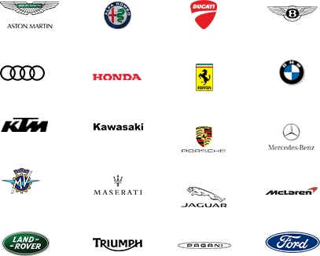





Pirelli Overview
Ferrari predominantly provides luxury vehicles, merchandise, and racing technology to high-value clients worldwide
Pirelli’s Unique Market Positioning as Leader in Prestige Segment Majority of revenue generated from High-Value Automobile market
1
Pure Consumer Tire Company: Specializes in high-value tires for cars, motorcycles,
and bicycles.
High Value
Standard
6,880
6,916
7,044
2
Competitive Edge: Competes with Tier 1 producers, offering high-quality, premium-
priced tires. Associated with exclusivity, luxury, and innovation.
5,545
Market Presence: Leader in the Prestige segment, with +50% market share in Original
Equipment channel. 18 factories in 12 countries, 20,000 POS in +160 countries
4,474
71%
75%
76%
3
71%
Performance s Innovation: Focus on safety, grip, noiselessness, and top-tier
performance.
70%
4
Certification: Pioneered the use of FSCTM-certified natural rubber and aims to use
solely FSCTM-certified rubber in European factories by 2026.
30% |  | 29% |  | 29% |  | 25% |  | 24%
2020 |  | 2021 |  | 2022 |  | 2023 |  | 2024
5
Sustainability s Innovation Objectives
Pirelli’s Motorsport Leadership s Strategic Partnerships
100%
bio-based s recycled
materials tire by 2040
$27GM
USD investment
in RsD (2024)
Formula 1: Since 2011, Pirelli has been the sole-supplier to the Formula 1 World Championships.
Strategic OEM Partnerships
Focus on EV Tires Development
G7.4%
Waste sent to
recovery
Paying to be F1 Supplier: Pirelli won the sole-supplier rights/contract for 2025- 2027 with the option to extend for 1 year.
5,G00
Patents
-30%
Wear rate reduction by 2030
Intense Competition:
Bridgestone, Japanese brand tire
manufacturer was 2010 F1 supplier, considered valid candidate in most recent F1 supplier contract formation.
72%
Electricity from
renewable resources
Net Zero
by 2040
(Pirelli, 2024)
Executive | Industry | Company | Financial | Acquisition | Alternative | Conclusion
Summary | Overview | Analysis | Analysis | Feasibility | Solution

Slide 13
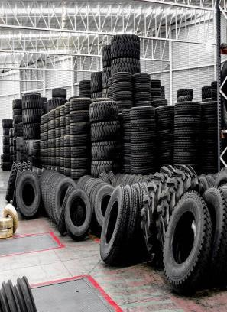
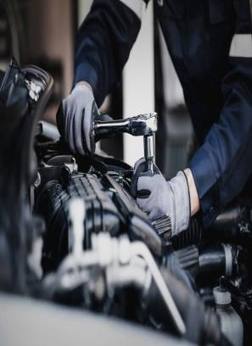
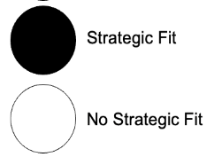
Strategic Fit
Crafting the future for a combined company
HOW?
EV-Specific Tire Development: Pirelli’s 900+ homologations for EV tires by 2025 directly address Ferrari’s need for advanced, high-performance tires tailored to electric powertrains. This ensures Ferrari’s 2025 EV and hybrid models can handle unique demands like instant torque and heavier battery loads. Real-Time Safety s Performance: Integration of Pirelli’s Cyber Tyre technology enhances Ferrari’s EVs by providing real-time data on road conditions and tire health, improving safety and dynamic performance—critical for Ferrari’s reputation as a leader in cutting-edge engineering.
Bespoke Tire Customization: Leveraging Pirelli’s manufacturing capabilities, Ferrari could offer premium tires (e.g., unique tread patterns, colors, or sidewall branding) to complement its new paint shop and personalization options. This strengthens Ferrari’s luxury appeal and client exclusivity. Co-Branded Prestige: A partnership would reinforce both brands’ motorsport heritage, creating premium co-branded products (e.g., limited-edition tires for Ferrari owners) that enhance perceived value and loyalty.
WHERE?
INNOVATION s PERFORMANCE ENHANCEMENT
BRAND PERCEPTION s CUSTOMER LOYALTY
HOW MUCH?
Strategic Alignments
EV TECHNOLOGY PROVIDER
CUSTOMIZED SERVICE PROVIDER
Executive |  | Industry |  | Company |  | Financial |  | Acquisition |  | Alternative |  | Conclusion
Summary |  | Overview |  | Analysis |  | Analysis |  | Feasibility |  | Solution

Slide 14



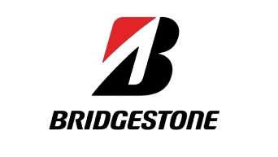

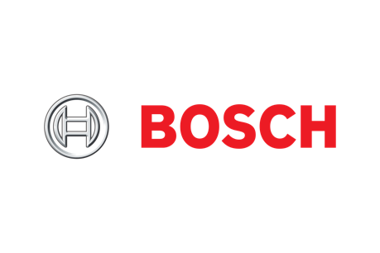





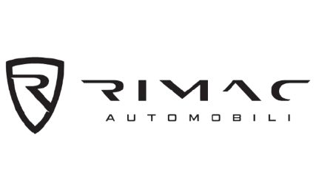

Potential Peer Group
Tires, EV Parts Manufacturers and AI Powered Performance Software are potential peer groups for Pirelli
Tires
Similar business models and revenue streams. Own and operate global supply chain networks
EV Parts Manufacturers
AI Powered Performance Software
Similar OEM supplier models and heavy RsD investments.
Maintain global footprint with strategic partnerships
Partner with automakers and component suppliers.
Focus on ADAS and predictive analytics as Pirelli
Executive |  | Industry |  | Company |  | Financial |  | Acquisition |  | Alternative |  | Conclusion
Summary |  | Overview |  | Analysis |  | Analysis |  | Feasibility |  | Solution

Slide 15


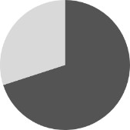
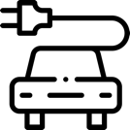
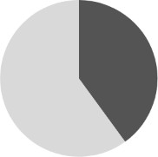

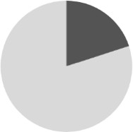
Comparable Company Selection
Due to discrepancies in the revenue and cost drivers to Pirelli AI Cars segment was discarded
Market size Market CAGR Brand relevance Revenue drivers Cost drivers Retained
 |  | 4.8% (' ) | - | High-Performance and Specialty Product Focus Expansion in Emerging Markets Direct-to-Consumer Sales Channels | Fluctuating Raw Material Costs Advanced Manufacturing Technologies Regulatory Compliance and Environmental Standards Labor Costs | -
Tire | $350bn | 4.8% (' ) |  | High-Performance and Specialty Product Focus Expansion in Emerging Markets Direct-to-Consumer Sales Channels | Fluctuating Raw Material Costs Advanced Manufacturing Technologies Regulatory Compliance and Environmental Standards Labor Costs
EV Parts | $300bn ('23) | 15.2% ('24-'28) |  | High-Performance and Strategic OEM Partnerships × Direct-to-Consumer Sales Channels | Fluctuating Raw Material Costs Advanced Manufacturing Technologies Regulatory Compliance and Environmental Standards Labor Costs
AI Cars | $250bn ('23) | 20.5% ('24-'28) |  | × High-Performance and Strategic OEM Partnerships Expansion in Emerging Markets Channels | × Fluctuating Raw Material Costs Advanced Manufacturing Technologies Regulatory Compliance and Environmental Standards Labor Costs
Raw material costs and traditional supply chains distinguish tire and EV parts Tires is the most comparable segment industries from AI-powered cars, which rely on software and data monetization.
Sources : FactSet (2025).
Executive | Industry | Company | Financial | Acquisition | Alternative | Conclusion
Summary | Overview | Analysis | Analysis | Feasibility | Solution

Slide 16









Peer Group Analysis
Pirelli is growing slower than its peers, but has a strong profitability due to its positioning and business model
Company Overview Sales FY23 ($ bn)
EBITDA Margin FY23 EBIT Margin FY23
Leader in high-performance and premium tires
Exclusive tire supplier for Formula 1
Global presence in over 160 countries
Strong focus on smart tire tech and
sustainability
+7%
6.9 7.1
6.3
17.5%
7.2%
+G%
28.5 28.3
One of the largest tire manufacturers globally
Innovator in run-flat and fuel-
efficient tires
Publisher of the Michelin Guide
for restaurants and travel
23.7
19.5%
13.4%
Major global supplier of passenger,
commercial, and aircraft tires
Known for developing airless and
high-durability tires
Operates in over 20 countries
worldwide
Supplier for automotive, aviation,
and industrial applications
Investing in smart tire technology
and airless tires
Owns the Firestone brand
+2%
31.2
Median 13.1%
Median 7.1%
29.5
30.6
18.1%
11.0%
+7%
20.8
17.4
20.0
8.2%
3.3%
Developing smart tires and advanced mobility technologies
Operations in over 60 countries
Diversified portfolio including
braking systems and electronics
+6%
41.4
39.9
44.7
7.6%
2.4%
Pirelli has a high EBITDA margin due to its focus on high-performance and premium tires, given its positioning and strong emphasis on smart tire technology
Pirelli has grown slower than some peers but maintains a strong profitability position
Sources : FactSet (2025).
Executive Summary
Industry Overview
Company Analysis
Financial Analysis
Alternative Solution
Conclusion
Acquisition Feasibility

Slide 17


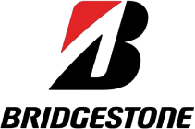
Peer Group Trading Multiples
Pirelli is trading at a significant premium to comparable companies – Ferrari should not pay this premium given a lack of synergies
Enterprise value ($ m)
EV/Sales FY22E-23E
EV/EBITDA FY22E-23E
P/E FY22E-23E
1.4x
8.3x
G,618
14.3x
1.3x
7.6x
1.1x
1.1x
5.9x
5.6x
31,045
7.2x
Median 0.7x
Median 5.8x
Median 11.7x
0.8x
0.9x
4.7x
4.7x
26,082
8.1x
0.5x
0.5x
5.2x
N/A
G,G34
6.0x
23,386
0.6x
7.9x
2.9x
0.5x 6.9x
FY23E FY22E
Pirelli trades at higher multiples than its peers, reflecting strong investor confidence in its premium positioning, but also implying higher expectations and valuation risk
Sources : FactSet (2025).
Executive | Industry | Company | Financial | Acquisition | Alternative | Conclusion
Summary | Overview | Analysis | Analysis | Feasibility | Solution

Slide 18









Precedent Transactions Analysis
Pirelli’s Valuation Warrants a Discount: 8-12x EBITDA is Justifiable
22.00x
Acquired
Acquired
Acquired
18.00x
2020-05-29
20.08x
2019-08-19
1G.81x
2023-03-27
15.33x
14.00x
Mean:
15.26x
Justifying a Discounted Multiple for Pirelli’s Acquisition
The precedent transactions range from 8.33x to 20.08x, with a mean multiple of 15.26x
Post-2022 deals saw lower valuation multiples, suggesting lower growth prospects in the sector or economic downturns
Due to lower growth potential s margins in tires market compared
to high-tech auto components, applying 15x precedent average
might overstate Pirelli’s valuation
An acquisition at 8-12x EBITDA would represent a moderate control premium in line with recent transactions.
Acquired
10.00x
Acquired
2023-03-20
12.74x
6.00x
2022-01-31
8.33x
2.00x
2020-01-01
2021-01-01
2022-01-01
2023-01-01
Executive Summary
Industry Overview
Company Analysis
Financial Analysis
Acquisition Feasibility
Alternative Solution
Conclusion

Slide 19
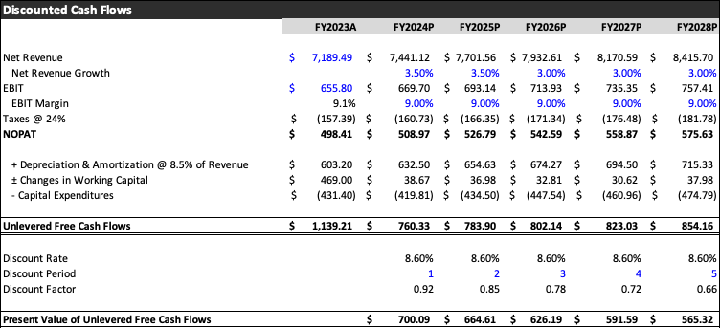
Pirelli Discounted Cash Flows
Pirelli’s Valuation and Free Cash Flows Projections
Cost of Debt
Pre-tax cost of debt 3.12% Tax rate 24.00%
After-tax cost of debt 2.37%
Cost of Equity
Risk-free rate 3.59% Market Risk Premium 13.86% Beta 0.67
Cost of Equity 12.94%
Cost of Capital (WACC)
Capital Structure
Market Value of Equity 59.00% Market Value of Net Debt 41.00%
Cost of Capital (WACC) 8.60%
Commentary
We assume conservative revenue growth rate in line with Pirelli’s historical growth and tire industry’s growth rate
Cost of Debt Assumptions
We use Italian Statutory Corporate Tax Rate in our model and use Pirelli’s
corporate bond’s yield as an estimate of cost of debt
Cost of Equity Assumptions
We assume 8.5% depreciation margin based on historical figures
Due to large fluctuations in net working capital in past, we spread the expected change in net working capital across 5 years to narrow down a more accurate present value of free cash flows
Risk-free rate assumption is based on Italy’s 10-year Treasury Bond Yield
We use FTSE MIB market return as a benchmark for market risk premium
and run a statistical analysis to calculate Pirelli’s beta in the market
Executive |  | Industry |  | Company |  | Financial |  | Acquisition |  | Alternative |  | Conclusion
Summary |  | Overview |  | Analysis |  | Analysis |  | Feasibility |  | Solution

Slide 20
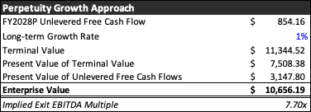
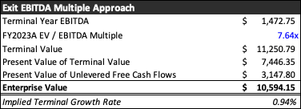
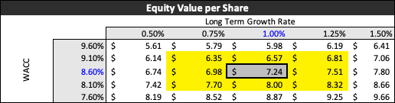
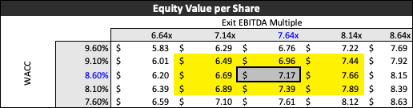
Pirelli Discounted Cash Flow Sensitivity Analysis
Perpetuity Growth and Exit EBITDA Multiple methods indicate a fair valuation of Pirelli
We assume a very conservative future growth rate in line with Italian
Treasury’s projections on Italian GDP Growth rate according to Reuters
We use Pirelli’s 2023 EV/EBITDA multiple due to it being less volatile post-
pandemic and recognizing Pirelli’s competitive advantage in the industry
Pirelli’s DCF Outputs Indicate that the company is fairly valued compared to its current market valuation at share price of $6.28
Executive |  | Industry |  | Company |  | Financial |  | Acquisition |  | Alternative |  | Conclusion
Summary |  | Overview |  | Analysis |  | Analysis |  | Feasibility |  | Solution

Slide 21

Synergies
Ferrari and Pirelli Achieve Strategic Value Through Collaboration
Synergies
Reasoning
Duration Impact
Revenue Synergies
Co-Branded High-Performance Tires
Joint Marketing and Promotional Activities
Integration in Motorsport
Platforms
Exclusive tires for Ferrari enhance
performance
Increase brand presence to reach a wider
audience
Pirelli's Formula 1 partnership showcases
Ferrari's high-performance capabilities
5+ Years
Cost Synergies
Lower Per-Unit Tire Prices
Shared Procurement of Raw
Materials
Optimized Supply Chain and
Logistics
Significant cost savings and technological
advancements benefit
Collaborative procurement offers bulk
discounts on materials like rubber
Reduce transportation and inventory costs
5+ Years
RsD Integration
More efficient resource allocation across Ferrari and Pirelli’s RCD teams
3% overlap in RCD expenses
related to tire development
eliminated
Ferrari has invested a lot of money in F1 performance, electrification, and tire innovation
Integration eliminates duplicate RCD efforts in
tire development, leading to cost savings.
3-5 Years
Supply Chain Synergies
Minimal synergies are expected as Pirelli already manages Ferrari's tire production
There are a few cost reductions
in storage or distribution
Pirelli is already the official tire supplier for Ferrari
Existing production, distribution, and storage processes are optimized, leaving little room for additional synergies
N/A
The co-branding and RsD integration represent the strongest synergies, helping with revenue expansion and cost optimization, while shared procurement, combined with the Formula 1 alignment, reinforces the distinct competitiveness
Executive |  | Industry |  | Company |  | Financial |  | Acquisition |  | Alternative |  | Conclusion
Summary |  | Overview |  | Analysis |  | Analysis |  | Feasibility |  | Solution

Slide 22
Cost s Revenue Synergies
Cross-Selling Revenues, Research s Development and Price Markup Cost Savings
Cross-Selling of Co-Branded Tires Research s Development Cost Savings
Ferrari can leverage co-branding synergies to cross and up-sell Ferrari-Pirelli tires to generate additional revenue, utilizing premium pricing due to the exclusivity and high-quality, targeting the growing UHNWI market.
Demand for luxury tires is forecasted to increase over the next several years,
providing Ferrari an opportunity to capture additional market share with their tire line.
Over the past 5 years, Ferrari and Pirelli's combined RsD Investment Growth rate was 7%. Continuing on this trajectory, 2025 is forecasted to be 1,381 Mil USD.
Cost Savings RsD
+7%
1,804
1,571
1,684
1,365
1,465
1,272
635.4
605.5
Cross-Selling C Up-Selling Ferrari Base Revenue
Ferrari has been heavily investing in features to enhance their offerings (F1, speed, tires, electrification, innovation). With an estimated overlap of 3% RsD expenses related to tire development, the acquisition can result in a -211.26M USD reduction in RsD expenses over the next 6 years.
699.5
666.7
770.2
734.0
+4,111.22M USD
2025 to 2030 Co-
Branded Tire Sales
-40 2025E | -38 -36 -34 2026E 2027E 2028E | -33 2026E | -31 2030E
-211.2GM USD 2025 to 2030 RsD Overlap
2025E
2026E
2027E
2028E
2029E
2030E
Cost Reductions from Pricing Markup Reduction
Supply Chain Synergies
2.47
2.54
2.62
2.69
2.78
Reducing Pirelli’s markup on tires will allow Ferrari to generate procurement cost savings, estimated around 15% of markup.
Pirelli is the official tire supplier for Ferrari, they handle the production, distribution, and storage of tires for Ferrari vehicles, therefore limited synergies will be generated from the supply chain and storage aspect.
2.39
Procurement Cost Savings
-12.64M USD
2025 to 2030 markup reduction
2025E 2026E 2027E 2028E 2029E 2030E
Executive Summary
Industry Overview
Company Analysis
Financial Analysis
Acquisition Feasibility
Alternative Conclusion Solution

Slide 23
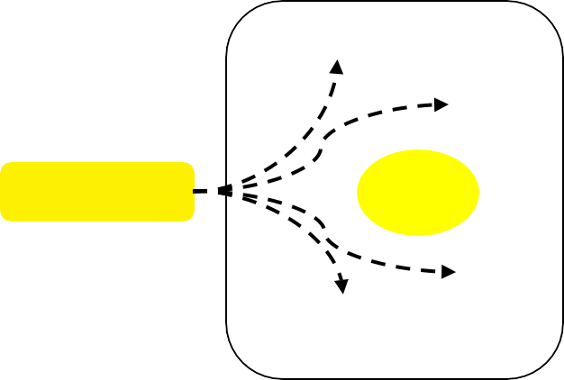

Acquisition Feasibility
Acquiring Pirelli disrupts operational efficiency and achieving strategic targets
Open Roads vs. Closed Lanes: The Trade-offs of producing tires
Roads to electrification, different destinations
Traditional Partnership work better…
Ferrari’s ~:4.7B R&D Investments towards electrification require:
Work with multiple tire suppliers to avoid dependency and maintain competitive pricing.
Tire Producers
Allows for both manufacturers to focus on core competencies and enables economies of scale.
Batteries
Electric Motors
Infrastructure
EV Tires
Automakers
(other)
Contracts
Suppliers have specialised RCD allowing them to adapt quickly to new vehicle releases and model modifications.
Ferrari
Inverters
High quality critical minerals
ADAS
Technology
Sustainable Solutions
Enable access to multiple suppliers
offering specialised solutions.
Pirelli can assist Ferrari with these targets however it cannot comprehensively provide what Ferrari requires for its electrification needs.
While there are several challenges to vertical integration…
Pirelli targets 30M EV Tires sold by 2025 through:
Acquisition disrupts typical dynamics and puts sole focus on an individual supplier.
Tire Producers
Requirement for more integrated RCD and launch strategy can delay model releases.
Performance
EVs
Ferrari constitutes only a portion of these
targets since it sells ~10,000 cars annually.
Automakers
(other)
Contracts
Premium EVs
Furthermore, Pirelli focuses on scalable solutions for EV adoption personalised solutions.
In-house- production
In case of supply chain disruptions or inadequacy, the option to replace the supplier is eliminated.
Mass-Market EVs
Ferrari Pirelli
Automakers (other)
Contracts
Conclusion: Ferrari cannot acquire Pirelli without losing flexibility, supplier competition, and focus on core innovation. Vertical integration offers no advantage over strategic partnerships. Ferrari's need for bespoke EV solutions conflicts with Pirelli’s mass-market focus, limiting exclusivity and still requiring external partnerships.
Alienates us from suppliers with whom we have existing relationships.
(Pirelli Industrial Plan, 2024), (Ferra ri, 2022)
Company Analysis
Financial Analysis
Acquisition Feasibility
Alternative Solution
Conclusion
Executive Summary
Industry Overview

Slide 24




Acquisition Feasibility
The combined company’s market positioning is ill defined
A mismatch in expertise
Expertise Ferrari would need to develop to manage Pirelli:
Expertise Pirelli would need as a part of Ferrari:
Supply Chain
Raw material sourcing for tires, including overcoming
expected shortages
Global logistics related to navigating customs regulations, tariffs, and transportation networks across 150+ countries
High volume inventory management
Securing partnerships with suppliers for innovative materials
Negotiating contracts with automakers and other large corporations, shifting from a B2C to a B2B retailer
Developing new quality standards incorporating Ferrari,
Pirelli and Industry standards
Investment opportunities for tire-specific innovation
Establishing regional teams to meet diverse regulatory standards
Personalization
Developing personalized products and customisation
centres to cater to customer demand
Establishing flexible supply chains to handle special customization requests
Differentiating wider market offering from exclusivity
reserved for Ferrari
Incorporating high engagement B2C strategies and bespoke
services in business practices
Navigating value proposition of CX offering for wider market and Ferrari customers
Technology and digital platforms aimed at enhancing personalisation visualisation experiences
After sales services
Operations
Customer Experience
Ferrari risks brand dilution by diversifying into mass-market B2B tire sales, conflicting with its exclusivity-driven model and diverting focus from core competencies like high-performance automotive innovation. Acquiring a tire manufacturer to aid in assembly in its limited supply of cars would be an excessive investment.
Pirelli faces market isolation as rival automakers may avoid its tires due to perceived Ferrari bias, limiting its broad industry relevance and revenue streams. Through strategic divestment, it has also specialised primarily as a tire manufacturer- expanding its capabilities as a service provider is contradictory to their historic goals.
The acquisition misaligns capabilities as both companies are required to expand their capabilities past their core competencies.
Executive |  | Industry |  | Company |  | Financial |  | Acquisition |  | Alternative |  | Conclusion
Summary |  | Overview |  | Analysis |  | Analysis |  | Feasibility |  | Solution

Slide 25
Acquisition Feasibility
Multiple Valuation Methods suggests Pirelli is currently fairly valued
Current Price:
$6.28
FCFF Projections
+3%
Market
Comparable Companies
Intrinsic Valuation
Precedent Transactions
$760.33 $783.90 $802.14 $823.03 $854.16
52 Week Market High/Low
$5.18
$6.80
EV/Revenue FY2023A
$1.61
$6.65
2024 2025 2026 2027 2028
Conclusions
EV/EBITDA FY2023A
$3.88
$7.03
Financial Implications
Our valuation methods suggest that Pirelli is currently fairly valued
in the market, implying Ferrari would not gain from a discount or an
inherent mispricing.
Pirelli’s slow compound annual growth rate of 3%, might present
a concern for Ferrari’s future goals.
Strategic Implications
Pirelli might be better as a partner to Ferrari in part due to its poor alignment of their business models
P/E FY2023A
$5.97
$7.29
DCF EBITDA multiple
$5.62
$8.39
DCF Perpetuity Growth
$5.15
$9.00
Acquisition costs incurred will NOT
justify the synergies generated
EV/EBITDA
$6.65
$11.69
Ferrari should NOT acquire Pirelli
Executive |  | Industry |  | Company |  | Financial |  | Acquisition |  | Alternative |  | Conclusion
Summary |  | Overview |  | Analysis |  | Analysis |  | Feasibility |  | Solution

Slide 26
Finding the Ideal Market for Ferrari to Invest in
Tires vs AI-Powered Performance Software s Autonomous Driving vs EV Batteries
Luxury Tires Market | AI-Powered Performance Software Market s Automated Driving | EV Battery Market
+G.1% 89.65 58.08 2025 2030 | +23.4% CAGR 14.92 5.22 2025 2030 | 15.8% CAGR 371 85 2024 2034E
Mid-sized market size, steady growth | Small market size, unstable, rapid expected growth | Largest market size, high and steady expected growth
EV s SUV Growth, Technology Innovation: Rising EV and SUV boost demand for specialized tires with higher torque, weight, and efficiency needs | Consumers desire for AD (Level 2+ systems) lags behind automakers strategies, AI Technologies coming with uncertainties | Increasing Sales of EVs: Rising demand, government incentives, stricter emissions regulations, driving EV adoption
Executive |  | Industry |  | Company |  | Financial |  | Acquisition |  | Alternative |  | Conclusion
Summary |  | Overview |  | Analysis |  | Analysis |  | Feasibility |  | Solution

Slide 27

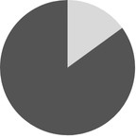
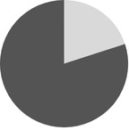
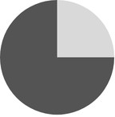
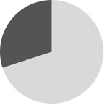


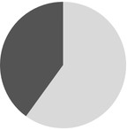
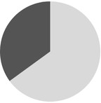
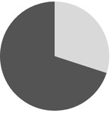

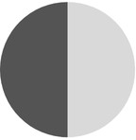
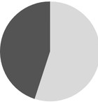

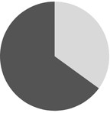

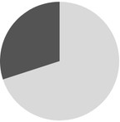

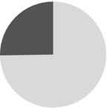
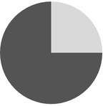

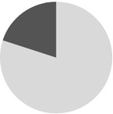
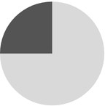
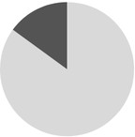
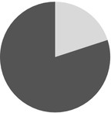

Potential Alternative Targets
SK On is the most promising acquisition target, based on the strategic fit, financial impact, feasibility and risks
Revenue FY24E
(3-year CAGR)
Financial
Impact
Feasibility
Company Overview
Strategic Fit
Risks
Incorporated in 2021 (spun off)
Focuses on lithium-ion batteries for electric
vehicles
Key offering is high-performance EV battery
solutions
Industry applications: auto C energy storage
$4.5Gb
(9.1%)
Incorporated in 2006
Focuses on lithium-ion battery and energy
storage
Key offerings are battery components and cell
chemistries
Industry applications: EV and energy storage
$0.37b
(16.1%)
Incorporated: 2011
Focuses on solid-state battery development
Key offerings is high-energy-density solid- state batteries
Industry Applications: EV, aerospace, energy
storage
$0.02b
(14.5%)
Incorporated in 1994
Focuses on specialty chemicals/lithium
production
Key offerings are lithium for EV batteries
Industry Applications: EV, electronics, oil
$5.38b
(-7.4%)
refining
Incorporated in 1906
Focuses on industrial solutions and tech.
Key offerings are aerospace systems and
automation solutions
$10.Gb
(5.2%)
Industry Applications: Aerospace, manufacturing,
energy
Ferrari's potential acquisition of SK On aligns well with its electrification goals, leveraging an This move could improve profit margins and existing partnership to enhance technological capabilities and accelerate EV development financial performance through vertical integration
Sources : StockAnalysis. (2025).
Executive | Industry | Company | Financial | Acquisition | Alternative | Conclusion
Summary | Overview | Analysis | Analysis | Feasibility | Solution

Slide 28










SK On Company Overview
SK On is the key missing element in Ferrari's strategic vision for the electric vehicle industry
01.
Business
Model
Financial Overview
SK On has strategically placed its operations across key automotive markets
The company is investing heavily in automation to improve operational efficiency and reduce costs across its facilities
Manufacturing of lithium-ion
batteries for electric vehicles
The company’s business model includes continuous investment in RsD to innovate battery technologies
SK On emphasizes working toward a circular economy
SK On is currently trading well below the industry median, and as operating performance improves, the stock could re-rate higher
Market mispricing offers significant upside as SK On nears profitability and narrows the valuation gap
04.
Operation
02.
Production
Trading Multiples
-G6%
0.6x
1.9x
_{-21%} -16%
-10% ^{-3%}
SK On is developing all-solid-
state batteries, which offer
advantages in energy density and
longevity over traditional batteries
The company is collaborating with research institutions to advance solid-state battery technology
03.
Research s
Development
SK On’s production is deeply
reliant on its robust supply
chain, which is designed to secure
essential raw materials
SK On collaborates with material suppliers to ensure that the raw materials are sustainably sourced
5.0x
-42%
While EBIT is still negative, the margin is fast improving, meaning operating losses are shrinking and revenue
growth is outpacing cost
growth
2.6x
4.2x
-85%
Main Business Segments
Emerging Segment
Battery-as-a-Service (BaaS): SK On is building
a circular battery economy with battery leasing
and AI-driven health monitoring
Large-Scale Segment
Energy Storage Systems (ESS): SK On’s grid-scale battery solutions help stabilize power grid and provide backup power for industrial use
Core Segment
EV Batteries: supplier of high-performance lithium-ion batteries, specializing in high-nickel NCM C NCMA batteries for major automakers
Strategic Partnerships
EV/Sales FY24E
EBIT Margin (%), SK On, 2018A-2023A
Key Takeaway
SK On has transformed from deep losses to near profitability with explosive revenue growth and operational efficiencies. As a leader in EV battery technology, SK On is positioned at the forefront of the electric vehicle revolution
Ferrari, with its push into the EV space, would be making a genius move by acquiring SK On to secure cutting-edge battery innovation
SK On, in partnership with Ford, is building cutting-edge
battery plants in the U.S., South Korea, China, and Hungary,
rapidly expanding toward a 150 GWh annual capacity to
become a top-three global EV battery supplier by 2025
Sources : SK. (2024), SK Innovation Newsroom SKinno News. (2020), SK. (2025), Park Jae-hyuk (2025)
Acquisition Feasibility
Alternative Solution
Conclusion
Executive Summary
Industry Overview
Company Analysis
Financial Analysis

Slide 29
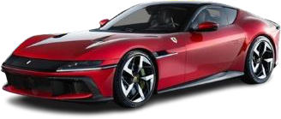
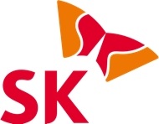

Ferrari and SK On Strategic Fit
Leveraging cutting-edge battery technology for Ferrari’s electrification future
Ferrari and SK On’s Weaknesses Ferrari and SK On’s Strategic Benefits
Ferrari’s Weaknesses
Limited Battery Expertise: No mature in-
house battery RCD
Supply Chain Dependency: Relies on
third-party battery suppliers
Late to EV Market: Lags behind others like Porsche and Rimac
SK On’s Weakness
No Supercar Expertise: Focuses on mass-market EVs
Competitive Industry: Faces rivals like
CATL C Panasonic
Brand Recognition: Strong in B2B but
lacks Ferrari’s prestige
Ferrari Gain
Direct control over battery tech s supply chain
Custom high-performance EV batteries
for Ferrari’s standards
Faster transition to luxury EVs without
relying on multiple suppliers
SK On Gain
Entry into high-performance EV market, strengthening its portfolio
Collaboration with a prestigious luxury
brand enhances its reputation Potential to develop premium battery
solutions for future supercars
The Power of this Strategic Alliance
Strategic Fit Summary
Global Market Leadership
As the fifth-largest EV battery supplier, SK On is geared to put Ferrari in a stronger position in both Europe and the U.S., while making use of its Fortune-recognized leadership in electrification to sync with Ferrari's premium markets.
Supply Chain Autonomy s Efficiency
Ferrari gains direct control over battery production, reducing supplier risks, while integrating SK On’s technology streamlines EV assembly for greater customization and performance optimization
Growth of Ferrari EVs: 40% targeting hybrid/EVs by 2030
SK On’s Market Position: the 5th largest EV battery supplier with
solid strength in the US C Europe
Exclusive battery supply: assures that Ferrari has direct control
over production C innovation
Competitive edge: maintain its status in ultra performance and
sustainable EVs
Exclusive Innovation Partnership
As Ferrari’s sole battery supplier, SK On enables dedicated R&D for high- performance EVs, accelerating innovation through focused collaboration rather than fragmented supplier networks
Ferrari partners with SK On, relying on new EV battery technology, and also strengthens supply chain control to accelerate high- performance electrification.
Premium Customer Solutions
SK On’s Battery-as-a-Service and energy management systems elevate Ferrari’s ownership experience, enabling flexible models and advanced performance enhancements
Executive |  | Industry |  | Company |  | Financial |  | Acquisition |  | Alternative |  | Conclusion
Summary |  | Overview |  | Analysis |  | Analysis |  | Feasibility |  | Solution

Slide 30
Financial Outlook on SK ON
Business being unprofitable may command lower acquisition multiples, while steep growth rate ensures future opportunities
SK ON has grown at a CAGR of 67.G% over the past five years, demonstrating
strong market expansion and increasing demand.
Despite historically operating at a loss, SK ON became profitable for the first time in Q3 2024, marking a significant milestone in its financial performance.
$14,162.60
$18.27
67.G%
$161.94
$8,761.69
$(350.31)
$45.61
$3,708.08
$161.03
$1,846.57
$631.33
2019
2020
2021
2022
2023
2Q24
Operating Porfit
Base Profitability Others Effect Enhancement
3Q24
Operating Profit
The company is projected to further improve its profitability in 2025, driven by expanded sales to existing customers and new customer orders.
Given SK ON’s historical unprofitability, Ferrari can negotiate a lower acquisition value at a more favorable multiple.
SK ON’s strong growth trajectory and recent shift to profitability present a strategic opportunity for Ferrari to expand its capabilities and meet its long-term objectives without incurring significant losses.
Executive |  | Industry |  | Company |  | Financial |  | Acquisition |  | Alternative |  | Conclusion
Summary |  | Overview |  | Analysis |  | Analysis |  | Feasibility |  | Solution

Slide 31
Ferrari and SK On Revenue s Cost Synergies
Ferrari will see additional revenue inflows from EV Battery Sales to Luxury Players and cost reductions in RsD
EV Batteries Additional Revenue Research s Development Cost Savings
Additional Revenue
SK On Battery Revenue Base
SK On has had a history of rapid growth in Battery Revenue, from 2018 to 2023, a decline in 2024, with expectations of recovery with a 5-year CAGR of 67.G%.
Synergies through directly selling high- performance batteries to other luxury brands and collaborating with motorsport events (such as Formula E) will generate a new revenue stream.
Matching the EV battery market growth, demand for additional SK On batterys with post acquisition is expected to generate 12% incremental increase in battery sales.
Over the past 5 years, Ferrari and Pirelli's combined RsD Investment Growth rate was 7%. Continuing on this trajectory, 2025 is forecasted to be 1,381 Mil USD.
Cost Savings RsD
+7%
776
1,622
1,734
1,420
1,518
766
1,243
1,328
749
Ferrari has been heavily investing in features to enhance the EV development of their offerings to meet their 2040 objectives. With an estimated redundancy of 5% RsD expenses related to tire development, the acquisition can result in a -408.62M USD reduction in RsD expenses over the next 6 years.
726
698
-66
2025E
-75 2026E
-81
2027E
-87 2028E
-64
2026E
-101 2030E
665
-408.62M USD
2025 to 2030 RsD Overlap
+4,37G.72M USD
2025 to 2030 EV Battery New
Sales
Cost Reductions from Pricing Markup Reduction
Procurement Cost Savings
26.25
27.57
Pricing Markup: Reducing SK On’s markup on EV batteries will allow Ferrari to generate procurement cost savings, estimated around 15% of markup.
-11G.32M USD
2025 to 2030 markup
reduction
22.68
23.81
25
21.6
2025E 2026E 2027E 2028E 2029E 2030E
(Software, D. 2023), (Ferrari, 2023) |  |  |  |  | 2025E 2026E 2027E 2028E 2029E 2030E
Executive | Industry | Company | Financial | Acquisition | Alternative | Conclusion
Summary | Overview | Analysis | Analysis | Feasibility | Solution

Slide 32
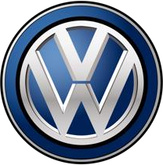


Acquisition Feasibility
Leveraging SK On for EV Technology, Revenue Diversification C Energy Solutions
Automakers increasingly acquire or vertically integrate EV-critical
technologies to secure supply chains and differentiate offerings
Acquiring SK On Before Profitability
Current valuation reflects short- term losses, not long-term potential. Margins expected to rebound post-2025 as factories scale and subsidies lower costs. Ferrari could acquire SK On at a discount, mirroring VolksWagen’s early bet on QuantumScape
Ferrari ensures high-performance solutions by gaining direct control over:
Battery
Design
Chemistry
Production
Revenue Diversification s Personalization Through Service Integration
Leveraging SK On’s Partnerships with Hyundai C Ford
Utilising SK On’s Service Lines
Ferrari's Expansion into Energy Solutions
Diversified revenue streams offset Ferrari’s
RsD costs
Branded Home Storage C Solar-linked Charging
Ferrari Energy Network: App-
controlled charging solutions
Enhanced customer experience with Ferrari ecosystem
High demand ensures stability s innovation funding
Battery as a Service C Energy Storage as a Service
Low upfront EV costs
+ Recurring Revenue
from Battery Leasing
Custom subscription models boosting demand
SK On’s business model integrates well with Ferrari’s vision. With undervalued market position and strong future growth potential, acquiring SK On presents a rare opportunity for Ferrari to enter the EV ecosystem at a discount while securing a long-term competitive advantage.
Executive |  | Industry |  | Company |  | Financial |  | Acquisition |  | Alternative |  | Conclusion
Summary |  | Overview |  | Analysis |  | Analysis |  | Feasibility |  | Solution

Slide 33
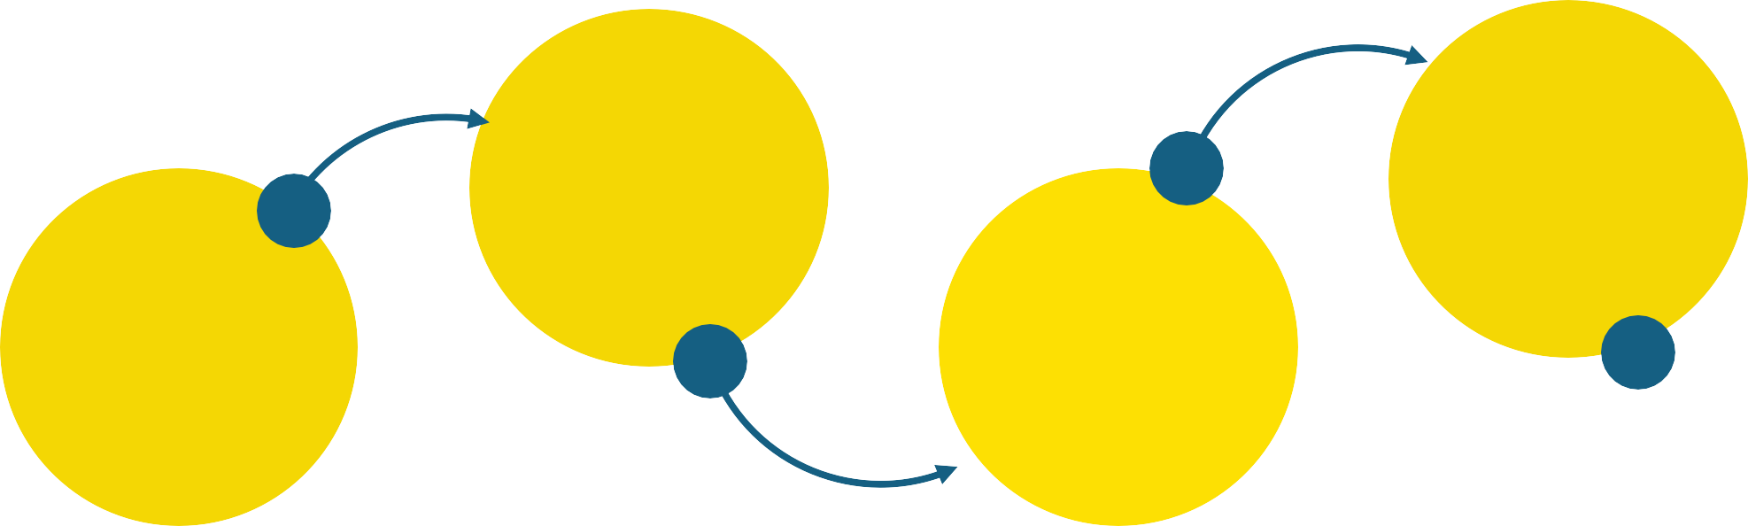


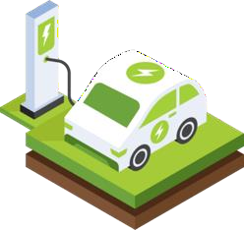

Conclusion
Ferrari should not acquire Pirelli and instead focus on acquisition that better aligns with its strategic initiatives
Why Pirelli doesn’t align with Ferrari’s strategy
Future of EV Batteries Market
Pirelli focuses on mass-market tire production rather than specialized EV
battery technology.
Limited synergies exist, as Ferrari already has tire partnerships that meet its needs without requiring acquisition.
Acquiring Pirelli would dilute Ferrari’s brand, introduce operational
inefficiencies, and require further investments to meet electrification goals.
The EV market is experiencing rapid growth, driven by increasing government regulations, consumer demand, and technological advancements.
Luxury automakers, including Ferrari, must strategically align with EV battery suppliers to ensure competitiveness in an electrified future.
03
01
04
Why SK ON is a better Alternative
SK ON is Ferrari’s exclusive EV battery supplier and aligns with its goal of integrating cutting-
edge battery technology.
SK ON is currently valued at a lower multiple due to historical unprofitability, presenting an opportunity for Ferrari to acquire it at a discount.
Its strong growth trajectory and improving
profitability position SK ON as a long-term strategic asset for Ferrari’s electrification goals
02
Ferrari’s strategic goals
Ferrari is committed to 60% of its sales from electric and hybrid models by 2026 and 80% by 2030.
The company prioritizes performance, exclusivity,
and luxury over mass-market expansion.
Executive |  | Industry |  | Company |  | Financial |  | Acquisition |  | Alternative |  | Conclusion
Summary |  | Overview |  | Analysis |  | Analysis |  | Feasibility |  | Solution

Slide 34
Appendix and Bibliography

Slide 35

Appendix
Pirelli Fair Enterprise Value Determination
Enterprise to Equity Value Bridge Football Field
$10,000
$1,05G
$4,478
$15.00
$G,3G5
$8,000
$12.00
In thousands USD
$9.00
Current
Price:
$6.28
$6,000
$5,G76
Diluted Shares Outstanding: 1,000,000
$6.00
$4,000
$3.00
$2,000
Implied Share
Price:
$5.G8
$-
DCF Value at 6.64x-
8.64x Exit EBITDA
multiple
DCF Value at 0.5%-
1.5% Perpetuity Growth Range
52 Week Market High/Low
$-
Enterprise Value
Cash
Debt
Equity Value
Enterprise Value via Exit EBITDA multiple Approach: $10.5G million
Enterprise Value via Perpetuity Approach: $10.66 million
Pirelli’s DCF Outputs Indicate that the company is fairly valued
compared to its current market valuation
Current Enterprise Value: $G.3G5 millions
+ Cash C Equivalents: $1.059 millions
- Total Debt: $4.478 million
Equity Value: $5.G76 million
Executive |  | Industry |  | Company |  | Financial |  | Acquisition |  | Alternative |  | Conclusion
Summary |  | Overview |  | Analysis |  | Analysis |  | Feasibility |  | Solution

Slide 36

Appendix
F1 Events
F1 and FIA WEC events F1 and GT Racing events
F1, FIA WEC, and GT racing events
FIA WEC Events
GT Racing Events
Executive Summary
Industry Overview
Company Analysis
Financial Analysis
Acquisition Feasibility
Alternative Solution
Conclusion

Slide 37


Appendix
110 GWh batteries, 2.5M EVs produced (2023)
Imports <20% of battery needs
Poland & Hungary
Produce ~90% of Europe’s batteries.
70 GWh batteries, 1.2M EVs produced (2023)
Imports <30% of battery needs
Japan & South Korea
12% of global cathode material capacity.
Expanding >400 GWh
capacity outside home markets (Europe, U.S.)
U.S.A
Manufacturing capacity grew by 45% in 2023 and is expected to surpass Europe's by the end of 2024 due to the Inflation Reduction Act (IRA) boosting local manufacturing.
France, Spain, & Germany
Produce ~70% of Europe’s EVs
China
Largest battery producer & exporter (~12% exported, 2023).
Used <40% of max output, far
exceeding domestic demand.
Cathode & anode capacity = 9× global EV demand (2023).
90% cathode, 97% anode material capacity.
~100% LFP, >75% NMC battery production.
Overcapacity
Major EV Producers (NA)
Major Battery Producers (Asia) Major Battery Producers (Europe) Increasing Investment Areas Major EV Producers (Europe)
Executive |  | Industry |  | Company |  | Financial |  | Acquisition |  | Alternative |  | Conclusion
Summary |  | Overview |  | Analysis |  | Analysis |  | Feasibility |  | Solution

Slide 38
Bibliography
Alexandre (2024) *Ferrari Electric: The Greatest Challenge That Could Also Be the Brand’s First Failure*. ItalPassion. Available at: https://www.italpassion.fr/en/ferrari/ferrari-electric-the-greatest-challenge-that-could-also-be-the-brands-
first-failure/ (Accessed: 10 March 2025).
Breunig, M., Kässer, M., Klein, H. and Stein, J. (2016) *Building Smarter Cars with Smarter Factories: How AI Will Change the Auto Business*. McKinsey C Company. Available at:
https://www.mckinsey.com/~/media/McKinsey/Business%20Functions/McKinsey%20Digital/Our%20Insights/Building%20smarter%20cars/Building-smarter-cars-with-smarter-factories.pdf (Accessed: 10 March 2025).
CnEVPost (2024) *Global Market Distribution of Battery Makers for Electric Vehicles in 1st Half 2024*. Statista. Available at: https://www-statista-com.myaccess.library.utoronto.ca/statistics/235323/lithium-batteries-top-manufacturers/
(Accessed: 26 February 2025)
CompaniesMarketCap (2024) *Continental (CON.DE) - Revenue*. Available at: https://companiesmarketcap.com/cad/continental/revenue/ (Accessed: 10 March 2025).
Edmondson, L. (2023) *Pirelli to Continue as F1 Tyre Supplier Until 2027*. ESPN. Available at: https://www.espn.com/f1/story/_/id/38621845/pirelli-continue-f1-tyre-supplier-2027 (Accessed: 10 March 2025).
European Commission (2021) *European Green Deal: Commission Proposes Transformation of EU Economy and Society to Meet Climate Ambitions*. Available at: https://ec.europa.eu/commission/presscorner/detail/en/ip_21_3541
(Accessed: 10 March 2025).
Evdesignandmanufacturing.com (2025) *Ferrari Sportscar Luxury Hybrid Electric EVs*. Available at: https://www.evdesignandmanufacturing.com/news/ferrari-sportscar-luxury-hybrid-electric-evs/ (Accessed: 10 March 2025).
Ferrari (n.d.) *Inside the Factory: The Engine Assembly Plant*. Available at: https:// www.ferrari.com/en-EN/magazine/articles/inside-the-factory-the-engine-assembly-plant (Accessed: 10 March 2025
Ferrari (n.d.) *Investors | The Official Ferrari Corporate - Ferrari.com*. Available at: https://www.ferrari.com/en-EN/corporate/investors (Accessed: 10 March 2025).
Ferrari (2023). FERRARI N.V. 2023 ANNUAL REPORT AND FORM 20-F. [online] Available at: https://cdn.ferrari.com/cms/network/media/pdf/Ferrari-2023-annual-report-april-17-2024.pdf.
Ferrari (2023) *Key Metrics | Ferrari Corporate - Ferrari.com*. Available at: https://www.ferrari.com/en-EN/corporate/key-metrics (Accessed: 10 March 2025).
Ferrari N.V. (2024) *2024 Annual Report and Form 20 -F*. Available at: https://cdn.ferrari.com/cms/network/media/pdf/Ferrari%20NV%20Annual%20Report%202024.pdf?_gl=1 (Accessed: 10 March 2025).
Ferrari.com (2016) *Sabelt Technical Partner - Ferrari.com*. Available at: https://www.ferrari.com/en-EN/formula1/partners/sabelt (Accessed: 10 March 2025).
Ferrariparts.com (2025) *What We Carry – Ferrari Partsource*. Available at: https://ferrariparts.com/what-we-carry/ (Accessed: 10 March 2025).
Goodyear Corporate (2024) *Goodyear Announces Q4 2024 and Full-Year 2024 Results*. Available at: https://news.goodyear.com/2025-02-13-Goodyear-Announces-Q4-2024-and-Full-Year-2024-Results (Accessed: 10 March 2025).
Grand View Research (n.d.) *Global Automotive Artificial Intelligence Market Report, 2030*. Available at: https://www.grandviewresearch.com/industry-analysis/automotive-artificial-intelligence-market-report (Accessed: 10 March 2025).
IRENA (2024) *Lithium-ion Battery Manufacturing Capacity Worldwide in 2023 with a Forecast for 2030, by Leading Region (in Gigaw att-hours per Year)*. Statista. Available at: https://www-statista-
com.myaccess.library.utoronto.ca/statistics/1550018/lithium-ion-battery-manufacturing-capacity-by-region-worldwide-forecast/ (Accessed: 26 February 2025).
Lepido, D. (2022) *There Will Never Be a Self-Driving Ferrari, CEO Vigna Says*. Bloomberg.com. Available at: https://www.bloomberg.com/news/articles/2022-06-16/there-will-never-be-a-self-driving-ferrari-ceo-vigna-says (Accessed: 10
March 2025.
Michelin (2024) *2024 Annual Results*. Available at: https:// www.michelin.com/en/publications/group/annual-results-2024 (Accessed: 10 March 2025).
Noble, J. (2018) *Ferrari: F1 Would Be ‘W rong’ to Ditch Pirelli*. Motorsport.com. Available at: https://www.motorsport.com/f1/news/ferrari-pirelli-tyre-supply-hankook/3208817/ (Accessed: 10 March 2025).
Pirelli (2024) *Pirelli Investor Relations*. Available at: https://corporate.pirelli.com/corporate/en-ww/investors/investors (Accessed: 10 March 2025).
Placek, M. (2023) *Size of the Global Autonomous Vehicle Market in 2021 and 2022, with a Forecast Through 2030*. Statista. Availabl e at: https://www.statista.com/statistics/1224515/av-market-size-worldwide-forecast/ (Accessed: 10
March 2025).
Reuters Staff (2024) *Tire Maker Goodyear to Invest C$575 Million to Upgrade Canada Plant*. Reuters. Available at: https:// www.reuters.com/business/tire-maker-goodyear-invest-c575-million-upgrade-canada-plant-2024-08-12/ (Accessed:
10 March 2025).
Shepardson, D. (2024) *US Finalizes $9.63 Billion Loan for Ford, SK On Joint Battery Venture*. Reuters. Available at: https://www.reuters.com/business/autos-transportation/us-finalizes-963-billion-loan-ford-sk-joint-battery-venture-2024-
12-16/ (Accessed: 10 March 2025).
SK Inc. (2023) *Financial Information | Investor Relations | SK Inc*. Available at: https:// sk-inc.com/en/ir/financialInformation.aspx (Accessed: 10 March 2025).
Software, D. (2023) *The Key Components of an Electric Vehicle*. Available at: https:// vin.dataonesoftware.com/vin_basics_blog/electric-vehicle-key-components (Accessed: 10 March 2025).
Team, C. (2024) *The Competitive Landscape of Aston Martin*. CBM. Available at: https:// canvasbusinessmodel.com/blogs/competitors/aston-martin-competitive-landscape (Accessed: 10 March 2025).
The Business Research Company (2025) *Tire Global Market Report 2025*. Available at: https://www.thebusinessresearchcompany.com/report/tire-global-market-report (Accessed: 10 March 2025).
Towards Automotive (2025) *Electric Vehicle Battery Market Soars 21.50% CAGR by 2034*. Available at: https:// www.towardsautomotive.com/insights/electric-vehicle-battery-market-sizing (Accessed: 10 March 2025).
Zurich.com (2024) *Leaders with L’acqua Goes Green: Ferrari CEO Benedetto Vigna*. Available at: https://www.zurich.com/knowledge/topics/climate-change/leaders-with-lacqua-goes-green-ferrari-ceo-benedetto-vigna (Accessed: 10
March 2025).
Executive |  | Industry |  | Company |  | Financial |  | Acquisition |  | Alternative |  | Conclusion
Summary |  | Overview |  | Analysis |  | Analysis |  | Feasibility |  | Solution

